Slide 1
Mobile Robotic Arm Controlled Via a Local Web Server
Noah Niedzwiecki
David Yablick
December 2nd, 2019

Slide 2
Outline
Project Goals
Arm Design
Base Design
Electronics
Challenges
Demo
Notes:
1

Slide 3
Project Goals
3+ DOF arm on a mobile base
Wireless control, either through Bluetooth, WiFi, or some other protocol
3D printable parts designed for standard screw sizes
Keep the electronics integration as simple as possible
Notes:
1

Slide 4
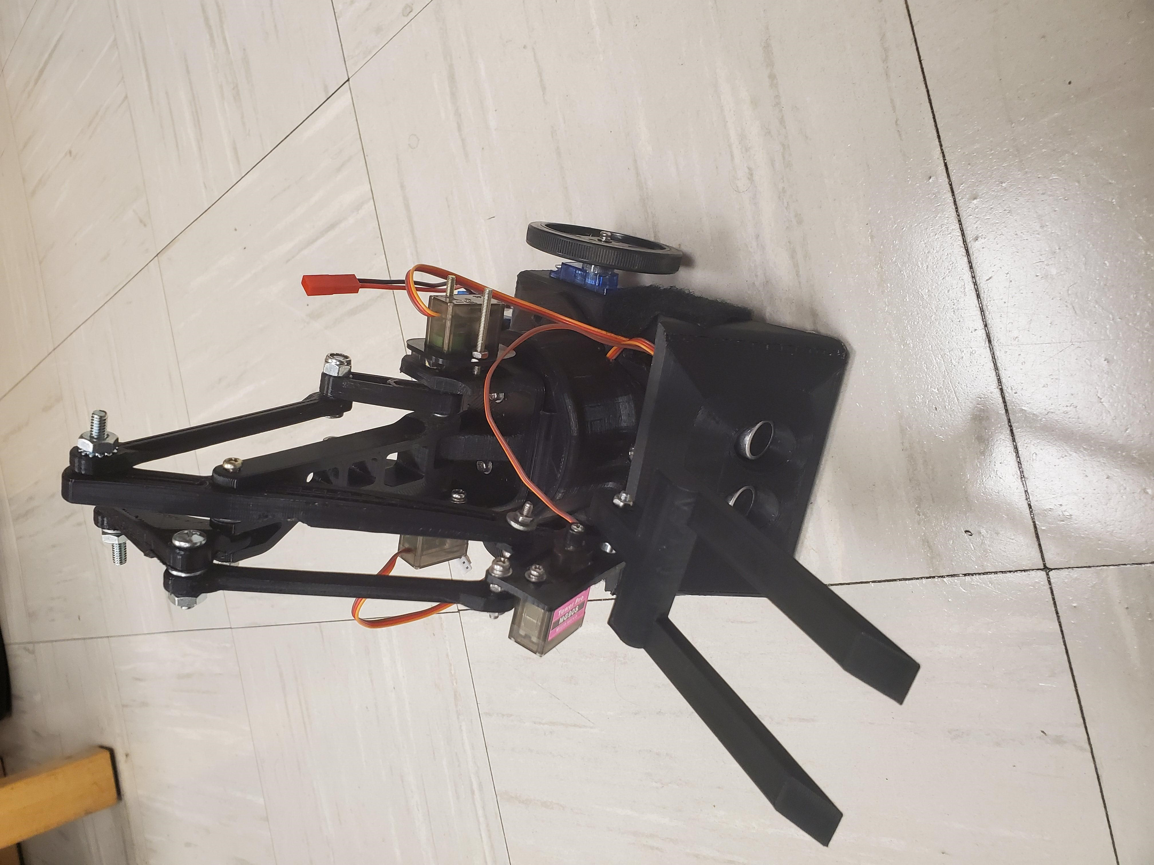
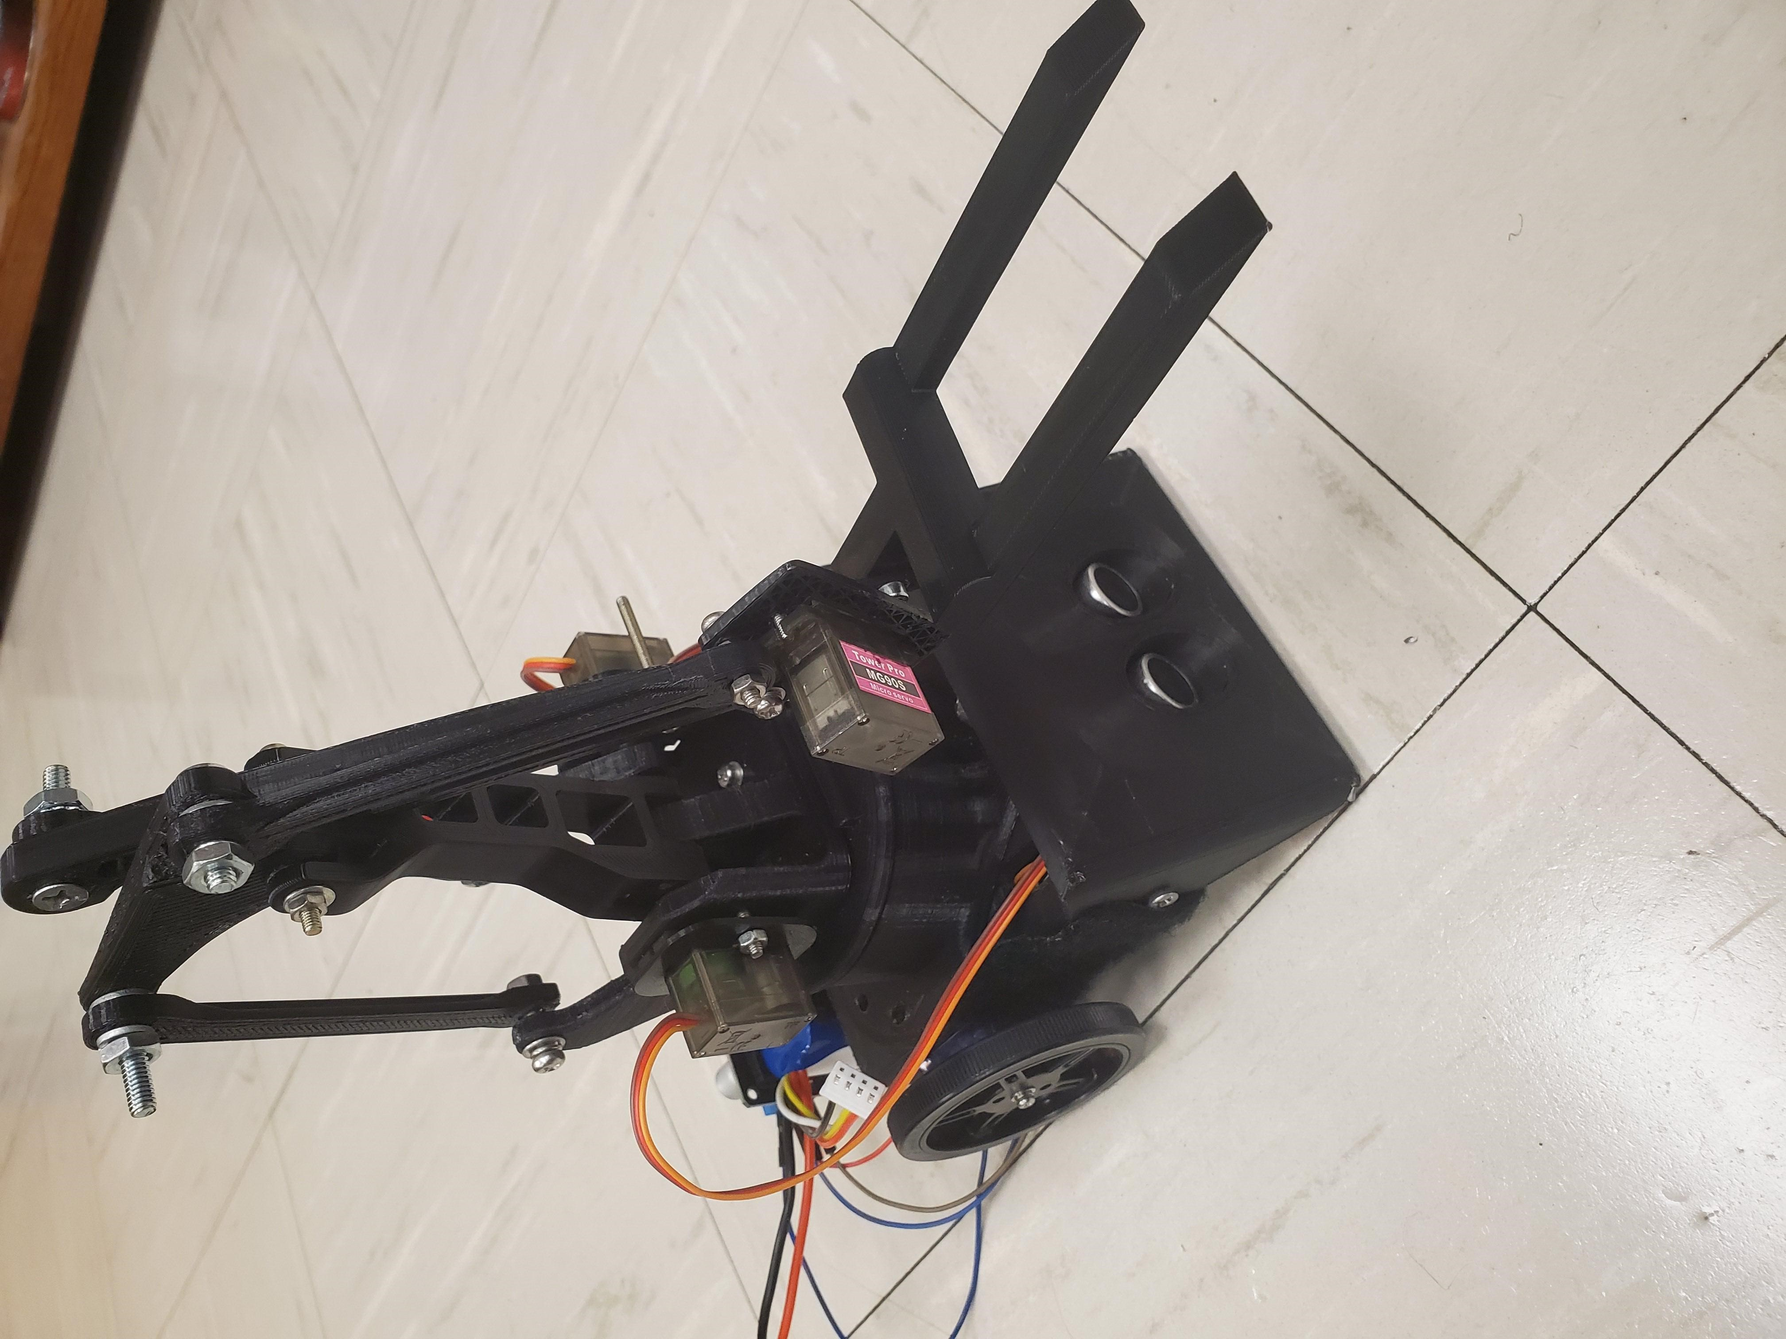
Meet Lil’ Servo
Notes:
1

Slide 5
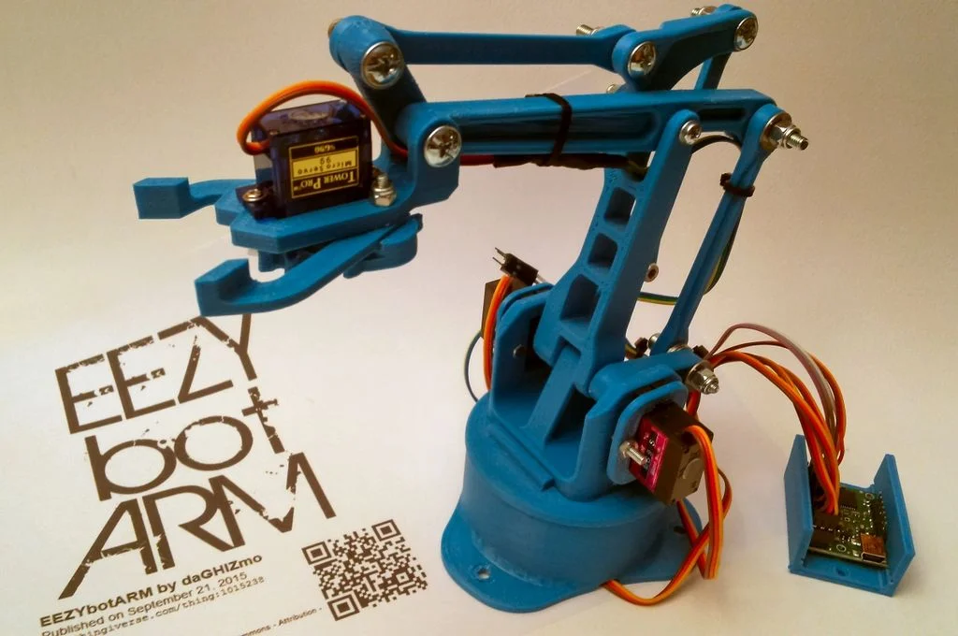
Arm Design
Based of EEZYbotARM
Designed for MG90S Servos
Printed on the CR-10 in the SPaRC lab (PLA)
Custom forklift design
Notes:
1

Slide 6
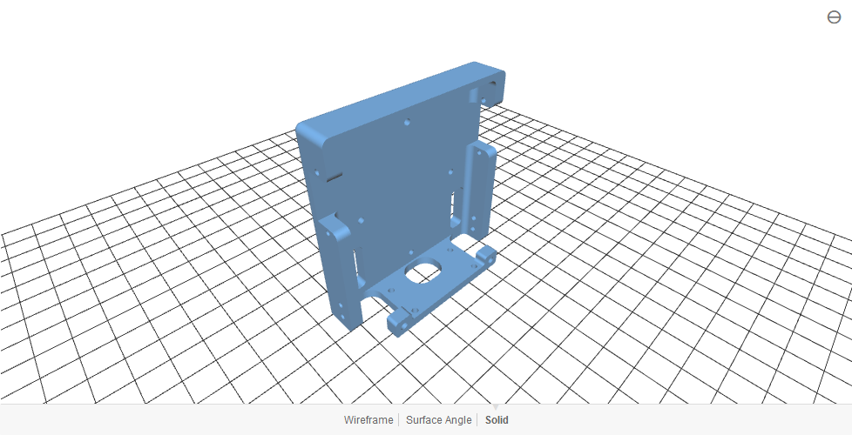
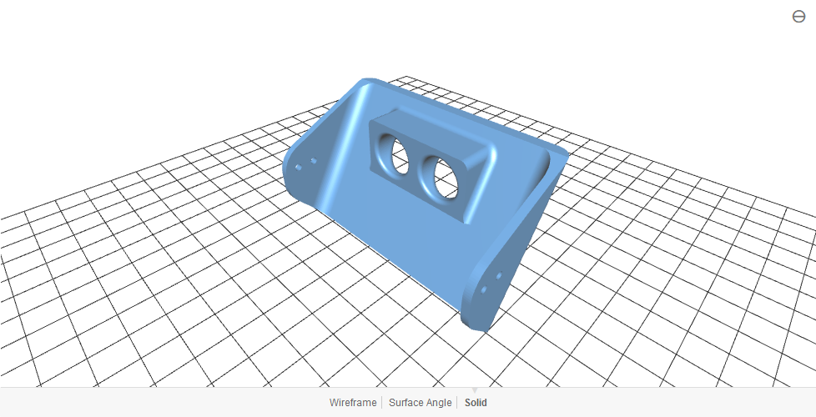
Base Design
Reused sumo-bot platform
Designed by Matthew Castleberry(2018)
Fitted with line sensors and ultrasonic range finders
Continuous servo differential drive
Notes:
1

Slide 7
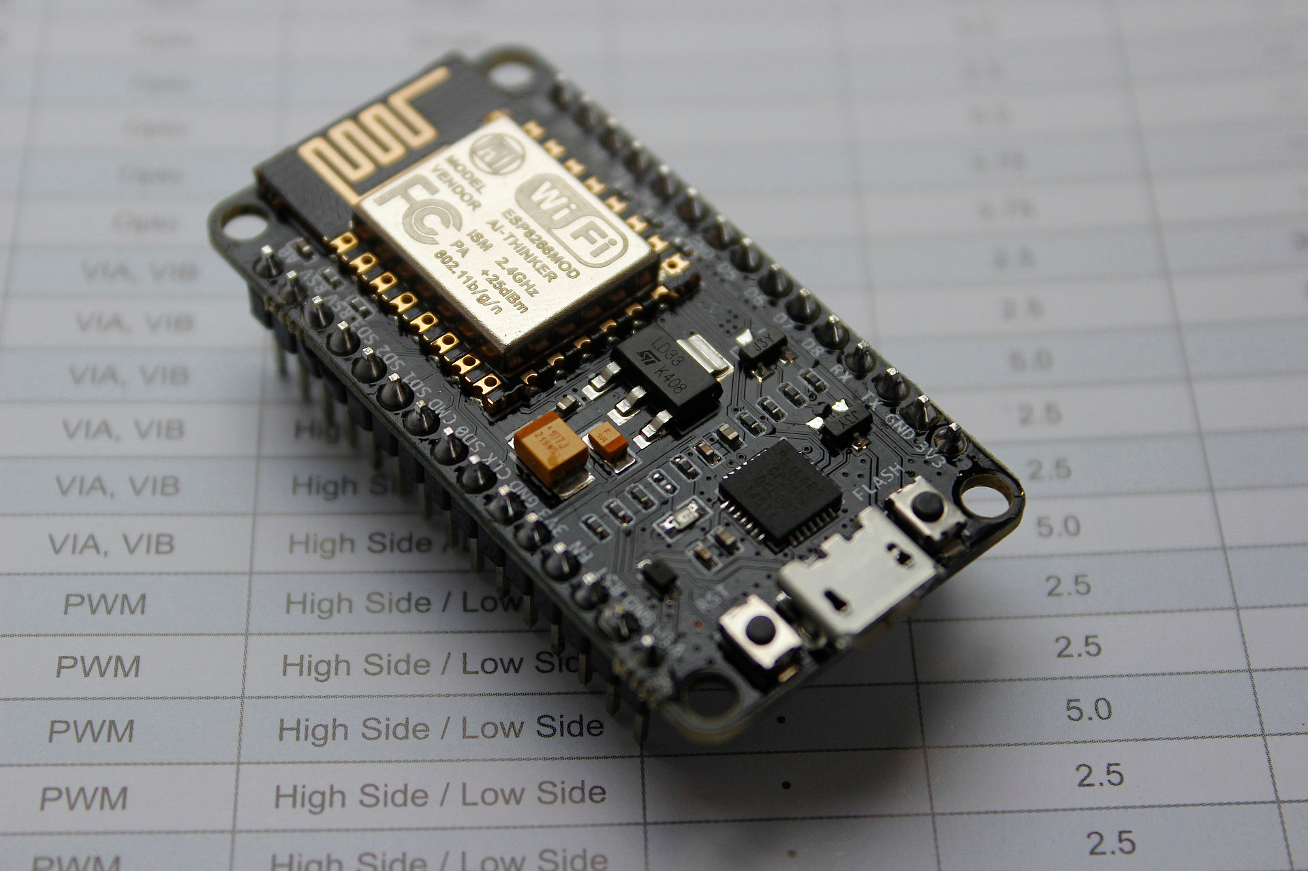
Electronics
Several different wireless communication protocols were considered. The ESP32 SoC made 2.4GHz / 5GHz IEEE 802 the top contender
NodeMCU is an open source IoT platform that can be programmed through the Arduino IDE
Can host its own web server with <50 lines of code
3.3V Logic
Notes:
<number>

Slide 8
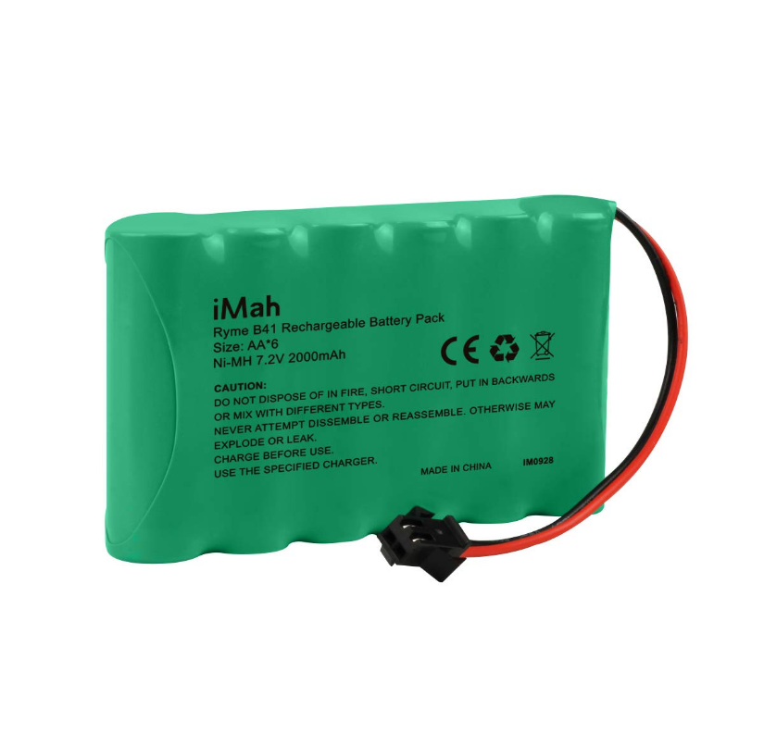
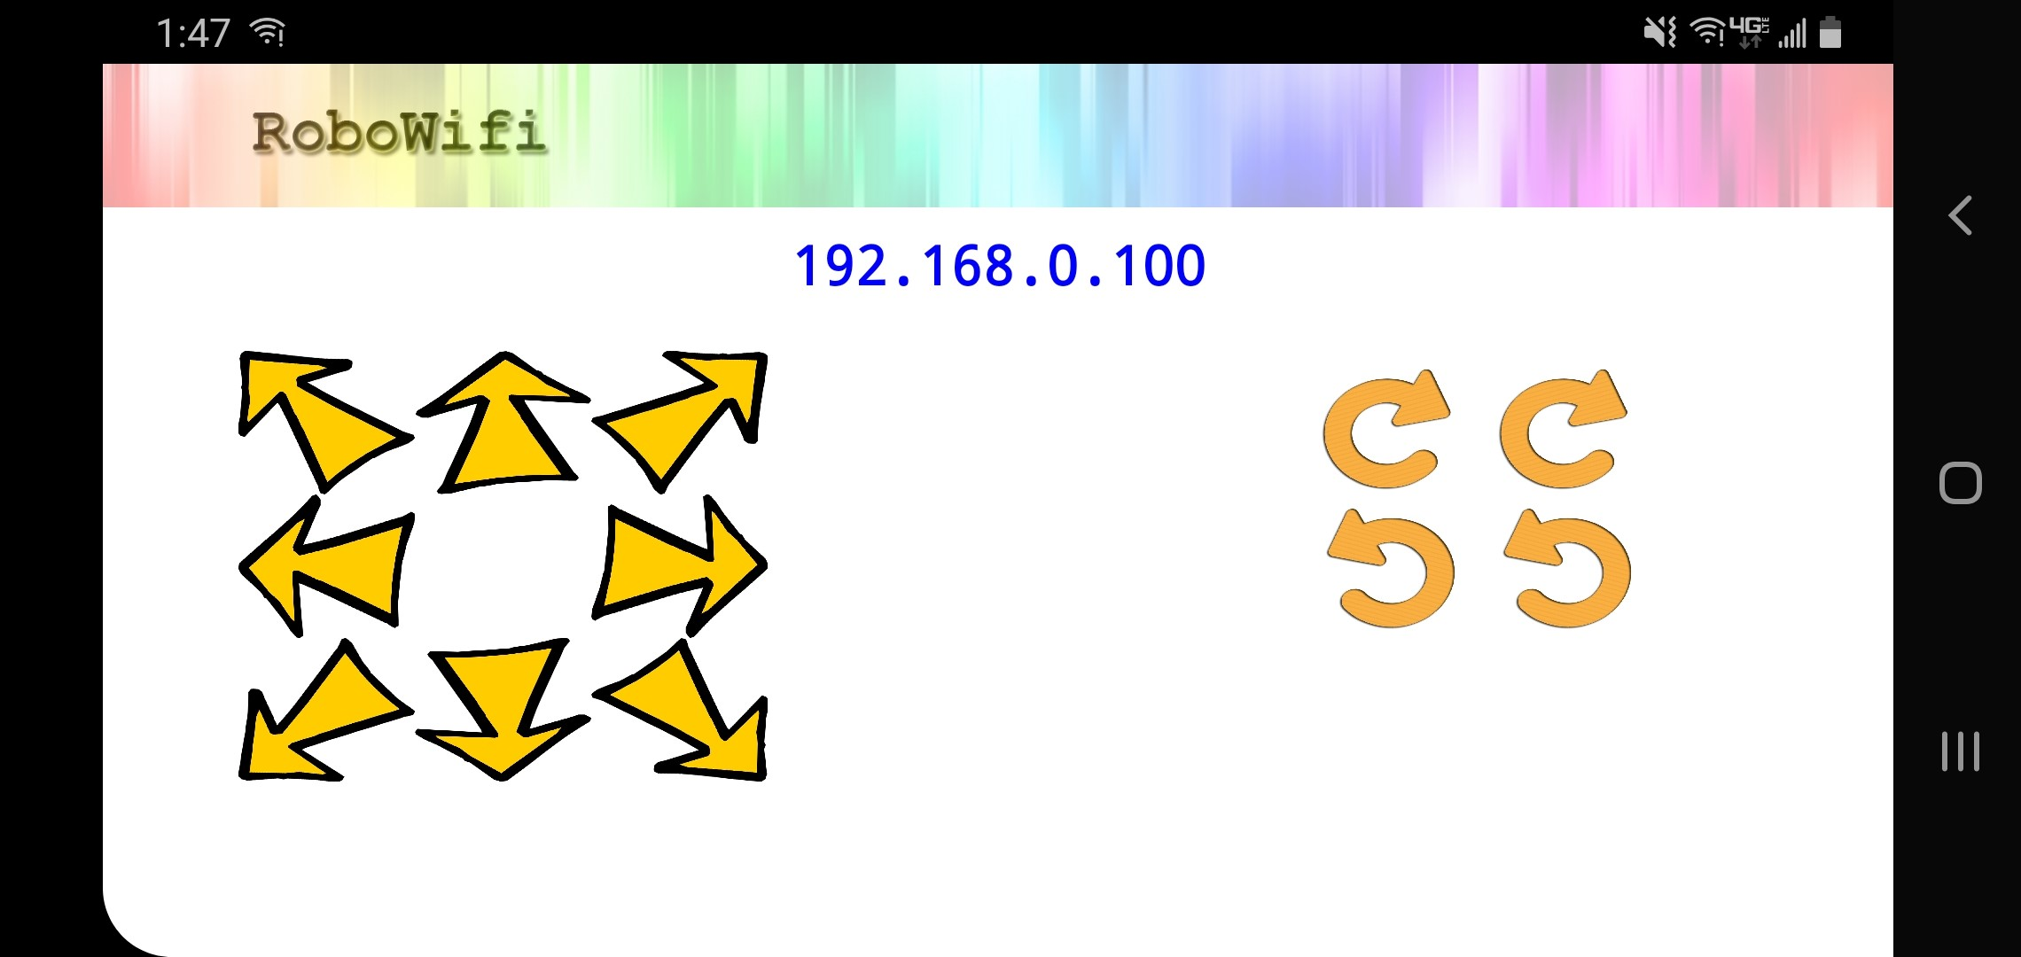
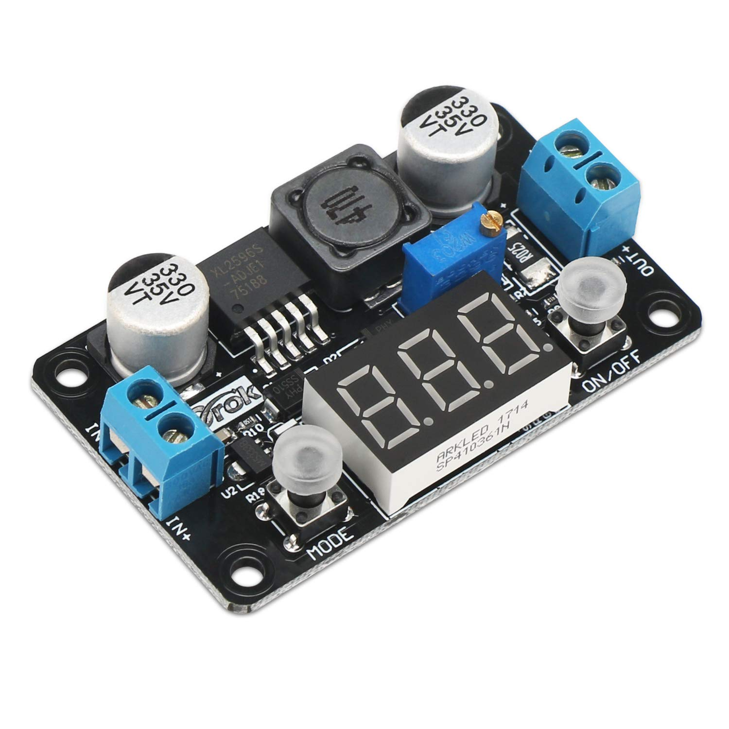
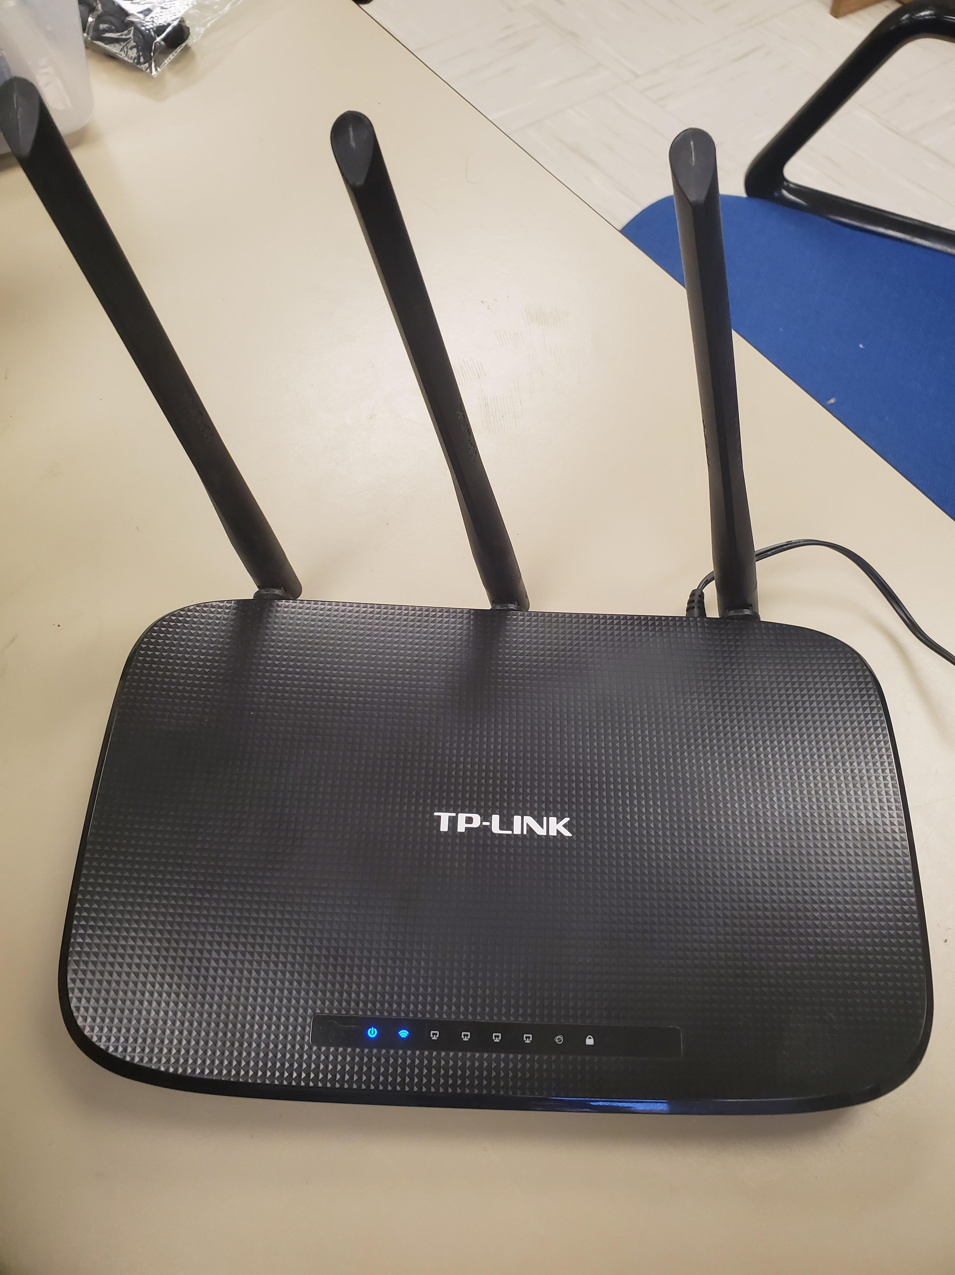
Electronics
Drok Adjustable Buck Converter
Random 7.2V battery
Custom servo drive board
TP-Link Router
RoboWifi App
Notes:
<number>

Slide 9
Challenges
Arm tolerances
Servos fighting each other
Jitter
Mechanical stability
Notes:
<number>

Slide 10
Demo + Conclusion
Will design custom arm assembly next time
Software runs well, easily scalable
Genuine servos might have been a good idea
Everything works as intended
Notes:
<number>

Slide 11
Questions?
Notes:
<number>

